Slide 2
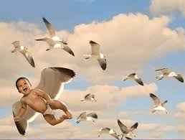
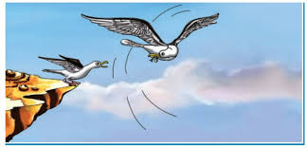

Slide 3
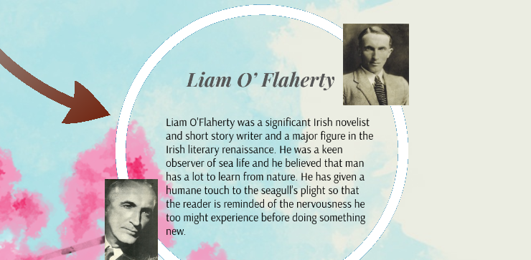
Born | 28 August 1896 Inishmore, Ireland
Died | 7 September 1984 (aged 88)
Literary Works (Novels) | Thy Neighbour's Wife (1923),The Black Soul (1924), The Informer (1925)
Literary Works (Short Stories) | Spring Sowing, The Tent, The Mountain Tavern, Two Lovely Beasts and Other Stories, Dúil

Slide 4
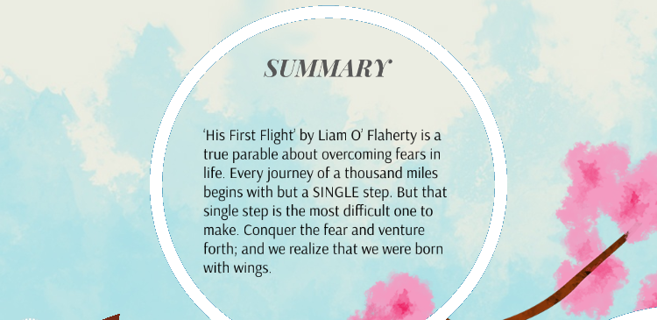
Theme

Slide 5
His First Flight: Introduction
The story by “Liam O’ Flaherty” is an account of a young bird that is afraid to fly for the first time. He believes that his wings would not support him. Despite his younger siblings flying fearlessly with much shorter wings, he could not gather the courage to do the same. He was punished to stay hungry if he did not try. Thus, it was his mother that compelled him to fly by using food as a trap. The lesson reflects how one hesitates to take the first step and that fear is all in the mind. One should trust one’s abilities because “the fear of suffering is worse than the suffering itself”.

Slide 6
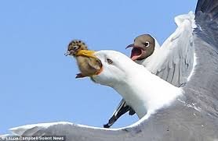
His First Flight: Summary
The story “His First Flight” by “Liam O’ Flaherty” is about a young seagull who is afraid to fly. All his younger siblings despite their much shorter wings flew fearlessly while he could not gather the courage to trust his own wings. The young seagull became sad when he saw his parents perfecting his younger siblings in the art of flying. His parents scold and taunt him for not even trying. They even call him a “coward”. They tell him a lot to at least try and also threaten him to leave him alone and hungry if he does not.

Slide 7
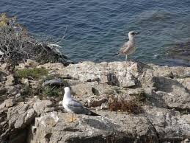
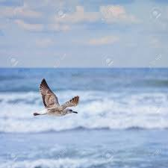
His First Flight: Summary
The following day, he is left in isolation and upon feeling hungry; he tries to seek the attention of his family members. Finally, he took his first flight. All the family members celebrate his victory by cheering and dancing around him. He also attempts at floating in the sea that he was once afraid of. Thus, he overcomes his fear and realizes that it is all in the mind.

Slide 10
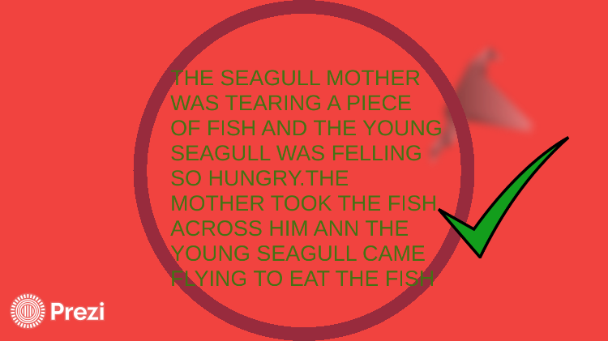

Slide 11
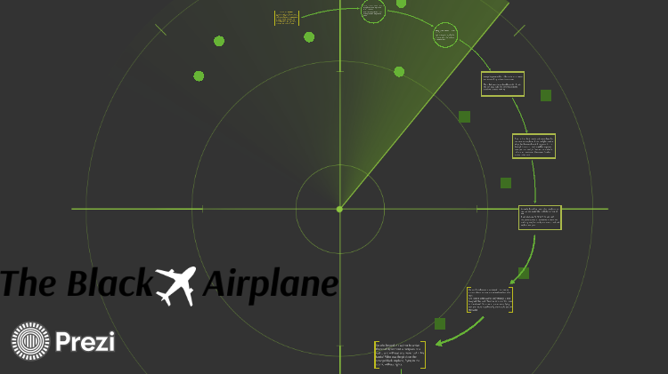

Slide 12
Writing Style
Forsyth uses his background as a journalist to create
in his novels an atmosphere of “being there” for the reader. His general style is also that of the journalist:
crisp, factual, and clear paragraphs that efficiently
convey information.

Slide 13
INTRODUCTION
The lesson “Black Aeroplane” by Frederick Forsyth reflects on how one’s judgement gets distorted due to fantasizing and how it creates problems. In this chapter, the narrator is a pilot who is so eager to meet his family and have a good breakfast that he takes the wrong decision of facing the storm instead of doing the right thing. Miraculously, he somehow manages to escape with the help of a mysterious aeroplane.

Slide 15
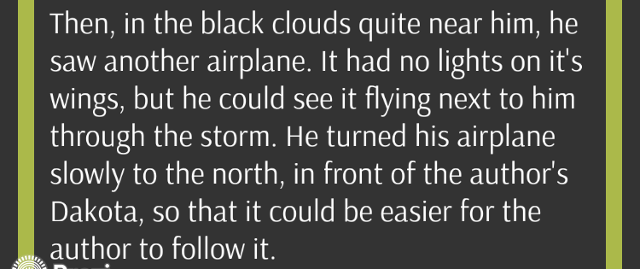

Slide 16
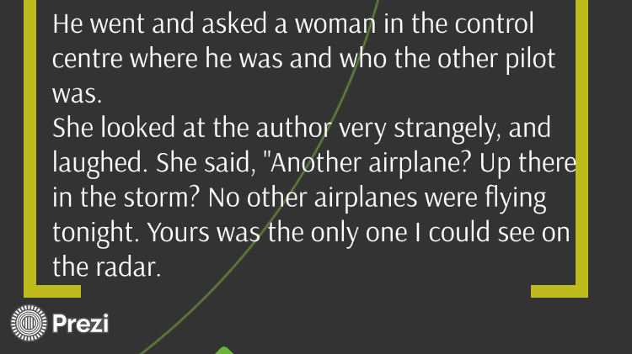

Slide 17
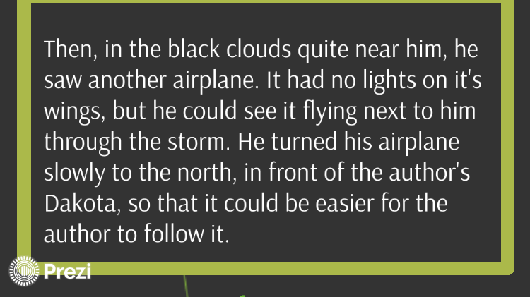

Slide 18
